Slide 1
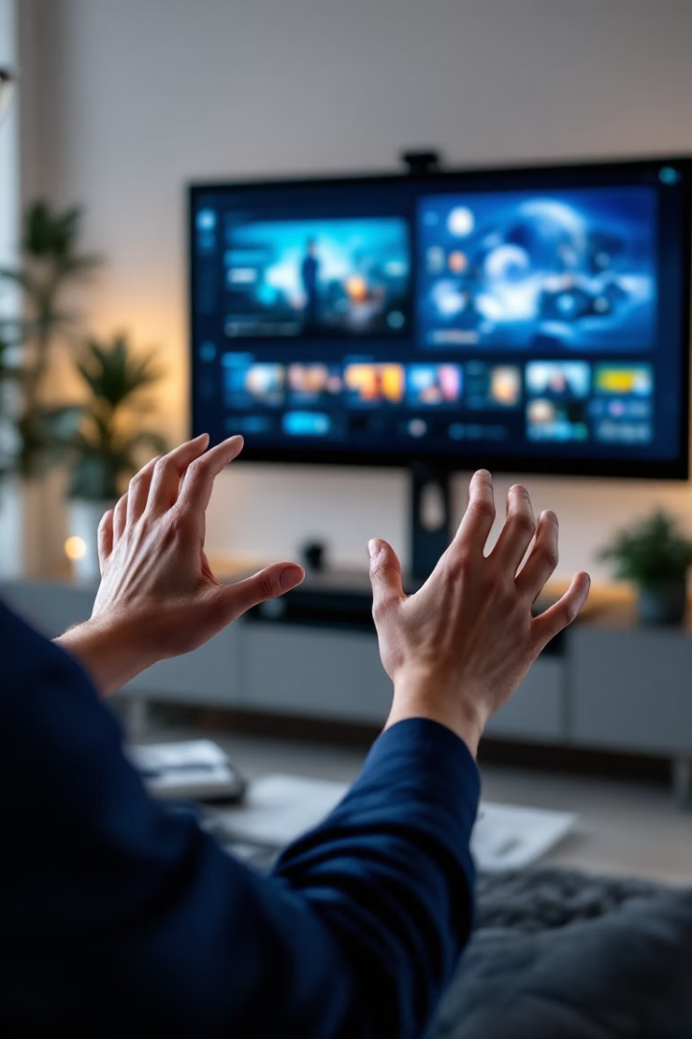
Hand Gesture Controlled Media Player
Computer vision project with OpenCV and MediaPipe
Control media through intuitive hand movements
Real-time gesture recognition for seamless interaction
Submitted by :
Karanvir Singh (102303435)
Sahil Popli (102303438)
Deepak (102303459)
Bibek Thagunna (102367009)
Siddartha Nepal (102367010)

Slide 2
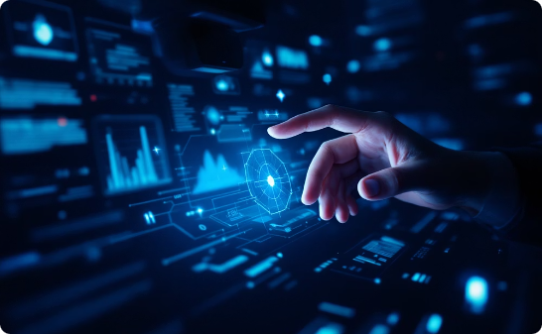
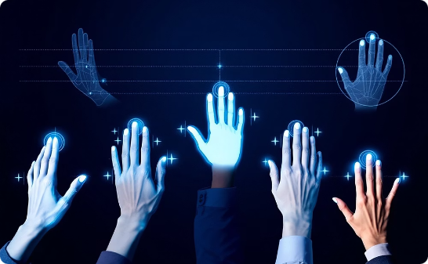
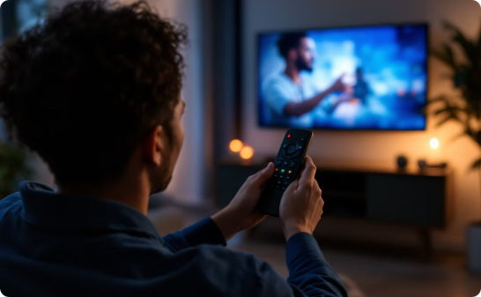
Project Overview
Webcam Capture
Six Key Gestures
Touchless Experience
Live detection via standard camera
Intuitive mapping to controls
Accessible media control

Slide 3






Technology Stack
Python
Core programming language
OpenCV
Image processing framework
MediaPipe
Hand landmark detection

Slide 4
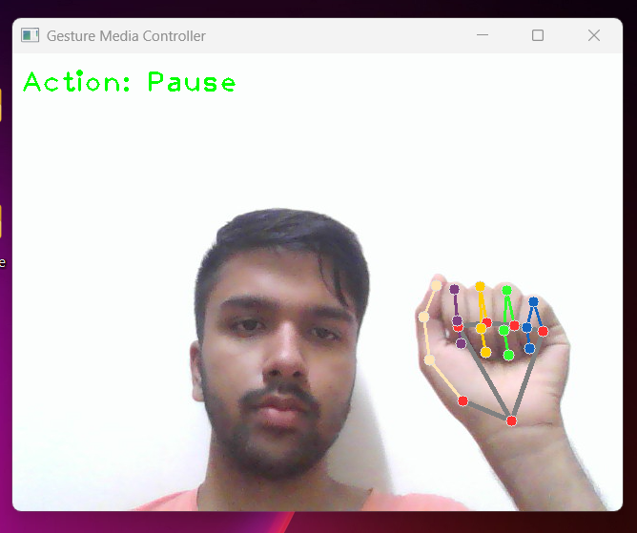
Gesture Mapping: Pause (Fist)
Fist Recognition
Closed hand triggers pause
Recognizes knuckle pattern
Filters accidental movements
Immediate response time

Slide 5
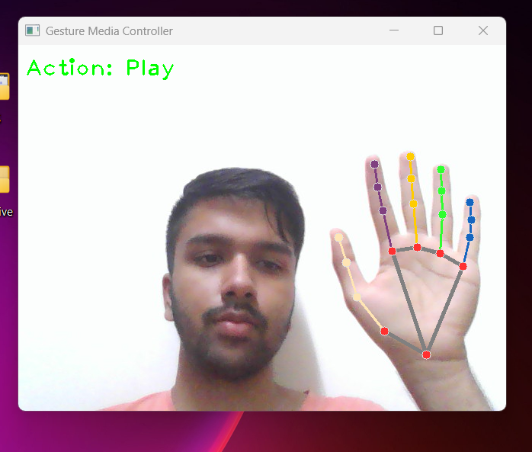



Gesture Mapping: Play (Five Fingers Open)
Detection Start
Camera captures open palm
Recognition
Five extended fingers identified
Action
Media playback begins

Slide 6
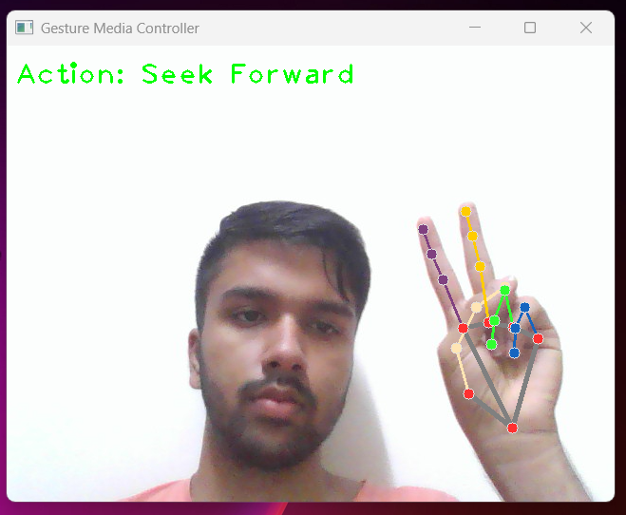



Gesture Mapping: Seek Forward (Two Fingers)
Two Fingers Up
Processing
Action
Peace sign detected
Gesture confirmed
Media skips forward

Slide 7
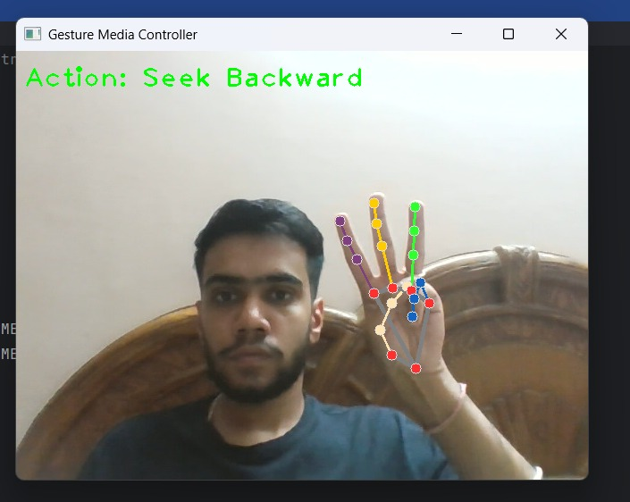
Gesture Mapping: Seek Backward (Three Fingers)
1
Three-Finger Detection
Index, middle and ring fingers extended
2
Gesture Recognition
Distinguished from other finger patterns
3
Backward Seek
Media rewinds for content review

Slide 8
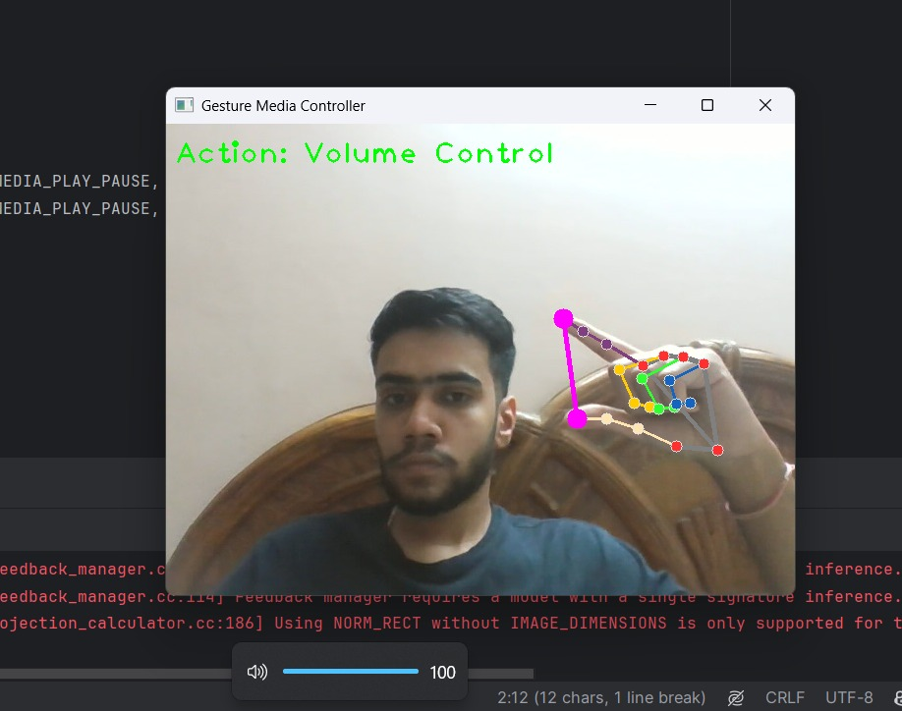
Gesture Mapping: Volume Control (Pinch Gesture)
Pinch Detection
Distance Mapping
Thumb-index connection recognized
Finger gap calculates level
Visual Feedback
Volume Adjustment
System volume bar level changes
Sound level changes accordingly

Slide 9
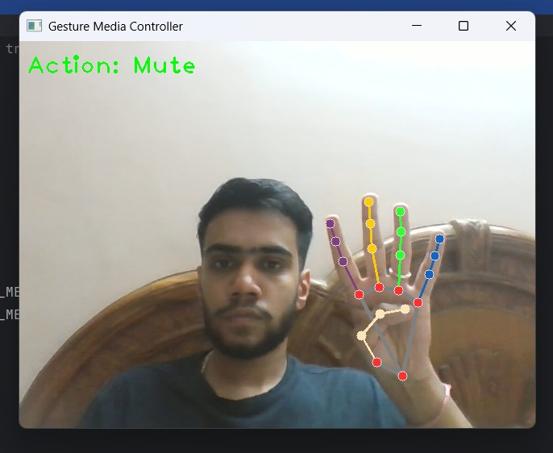
Gesture Mapping: Mute (Four Fingers)
Four Fingers Recognition
Four fingers trigger mute
Recognizes finger extension
Filters accidental movements
Immediate response time

Slide 10
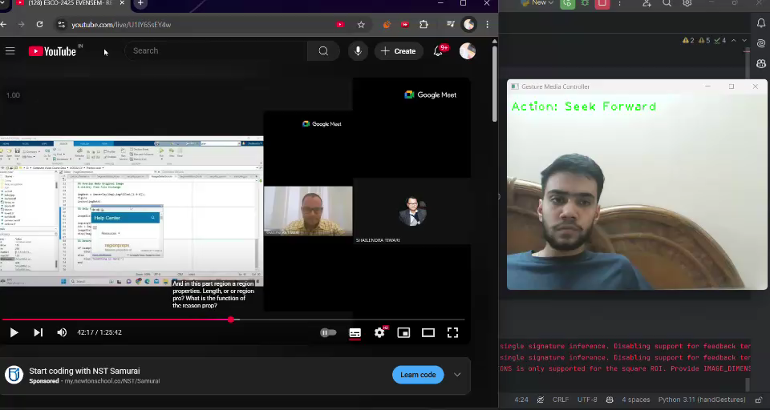
Video Demonstration
Thank You!
Click here if the video doesn't play!

